Slide 1
Clustering

Slide 2
Clustering
Class label is unknown
Clustering is the process of grouping a set of data objects into multiple groups or clusters so that objects within a cluster have high similarity, but are very dissimilar to objects in other clusters.
Categories of clustering techniques
partitioning methods,
hierarchical methods,
density-based methods, and
grid-based methods

Slide 3
K-Means Clustering Algorithm

Slide 4
K-means Algorithm
Discovers categories/groups in the dataset

Slide 5
K-means Algorithm
Step1: Choose the number K of clusters
Step2: Select at random k points, the centroids (not necessarily from the dataset)
Step3: Assign each data point to the closest centroid🡪 that forms k clusters
Step4: Compute and place the new centroid of each cluster
Step5: Reassign each data point to the new closest centroid. If any reassignment took place, go to step4, otherwise Stop (the model is ready)

Slide 6
Dataset
Step1: Choose the number K of clusters K=2
y
x

Slide 7
Dataset
Step2: Select at random k points, the centroids (not necessarily from the dataset)
y
x

Slide 8
Dataset
Step3: Assign each data point to the closest centroid🡪 that forms k clusters
y
x

Slide 9
Dataset
Step3: Assign each data point to the closest centroid🡪 that forms k clusters
y
x

Slide 10
Dataset
Step5: Reassign each data point to the new closest centroid. If any reassignment took place, go to step4, otherwise Stop (the model is ready)
y
x

Slide 11
Dataset
Step5: Reassign each data point to the new closest centroid. If any reassignment took place, go to step4, otherwise Stop (the model is ready)
y
x

Slide 12
Dataset
Step5: Reassign each data point to the new closest centroid. If any reassignment took place, go to step4, otherwise Stop (the model is ready)
y
x

Slide 13
Dataset
Step5: Reassign each data point to the new closest centroid. If any reassignment took place, go to step4, otherwise Stop (the model is ready)
y
x

Slide 14
Dataset
Step4: Compute and place the new centroid of each cluster
y
x

Slide 15
Dataset
Step4: Compute and place the new centroid of each cluster
y
x

Slide 16
Dataset
Step5: Reassign each data point to the new closest centroid. If any reassignment took place, go to step4, otherwise Stop (the model is ready)
y
x

Slide 17
Dataset
Step5: Reassign each data point to the new closest centroid. If any reassignment took place, go to step4, otherwise Stop (the model is ready)
y
x

Slide 18
Dataset
Step4: Compute and place the new centroid of each cluster
y
x

Slide 19
Dataset
Step4: Compute and place the new centroid of each cluster
y
x

Slide 20
Dataset
Step5: Reassign each data point to the new closest centroid. If any reassignment took place, go to step4, otherwise Stop (the model is ready)
y
Since no reassignment took place, Stop (the model is ready)
x

Slide 21
Dataset
Step5: Reassign each data point to the new closest centroid. If any reassignment took place, go to step4, otherwise Stop (the model is ready)
y
Since no reassignment took place, Stop (the model is ready)
x

Slide 22
relatively efficient with time complexity O(nkt) where-
n = number of instances
k = number of clusters
t = number of iterations

Slide 23
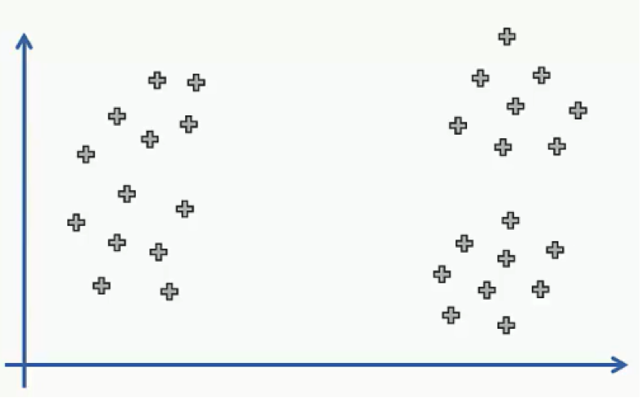
Choosing the correct number of clusters

Slide 24
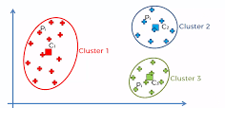
Choosing the correct number of clusters

Slide 25
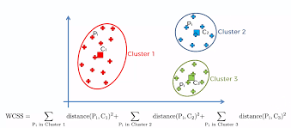
Choosing the correct number of clusters
With in clusters sum of squares

Slide 26
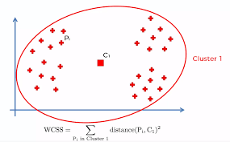
Choosing the correct number of clusters

Slide 27
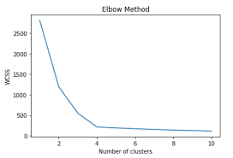
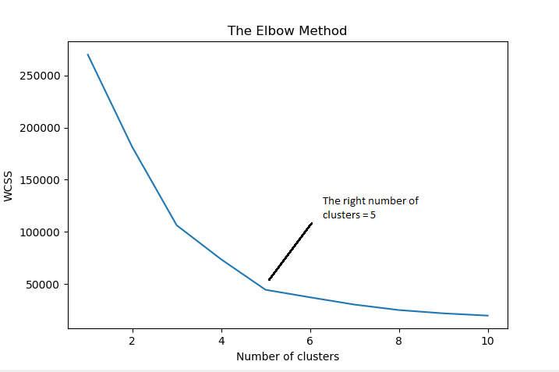
Choosing the correct number of clusters

Slide 28
Distance Metrics in Machine Learning
To deal with continuous or numerical variables
Euclidean Distance
Manhattan Distance
Minkowski Distance
To deal with categorical variables
Hamming Distance

Slide 29
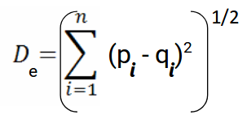

Formula for Euclidean Distance
Where,
n = number of dimensions
pi, qi = data points

Slide 30
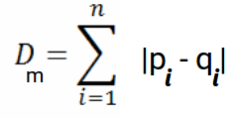

Manhattan Distance
is the sum of absolute differences between points across all the dimensions
Where,
n = number of dimensions
pi, qi = data points

Slide 31
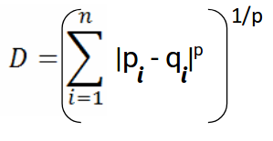
Minkowski Distance
Minkowski Distance is the generalized form of Euclidean and Manhattan Distance.

Slide 32
Hamming Distance
measures the similarity between two strings of the same length
is the number of positions at which the corresponding characters are different.

Slide 33
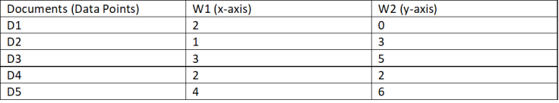
Example
Consider the below data set which has the values of the data points
Apply K-means algorithm to find two clusters.

Slide 34
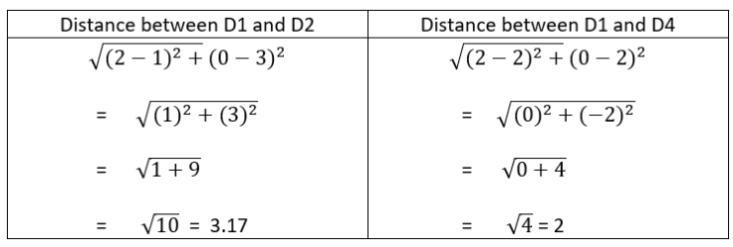
Iteration 1
Step 1: k=2
Step 2: randomly choose two initial points as the centroids- D2 and D4 are the centroids.
Step 3: We need to calculate the distance between the initial centroid points with other data points.

Slide 35
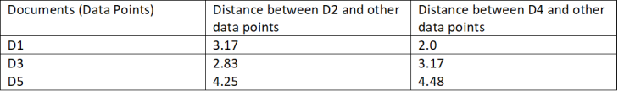
Step 3

Slide 36

Step 3: Next, we need to group the data points which are closer to centriods.
Cluster 1: (D1, D4) Cluster 2: (D2, D3, D5)
Step 4:Now, we calculate the mean values of the clusters created and the new centriod values will these mean values and centroid is moved along the graph.
new centroid for cluster 1 is (2.0, 1.0) and for cluster 2 is (2.67, 4.67)

Slide 37
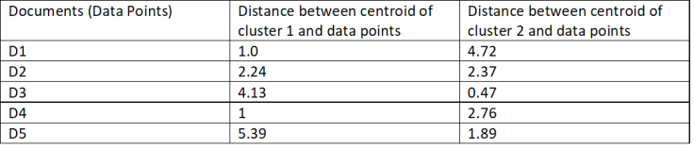
Iteration 2
Step 3:Again the values of Euclidean distance is calculated from the new centroids.
Cluster 1: (D1, D2, D4) Cluster 2: (D3, D5)

Slide 38

Step 4: Calculate the mean values of new clustered group
new centroid value as following:
cluster 1 ( D1, D2, D4) - (1.67, 1.67) and cluster 2 (D3, D5) - (3.5, 5.5)
Iteration 3…

Slide 39
Importing the libraries
import numpy as np
import matplotlib.pyplot as plt
import pandas as pd

Slide 40
Importing the dataset
dataset = pd.read_csv('Mall_Customers.csv')
X = dataset.iloc[:, [3, 4]].values

Slide 41
Using the elbow method to find the optimal number of clusters
from sklearn.cluster import KMeans
wcss = []
for i in range(1, 11):
kmeans = KMeans(n_clusters = i, init = 'k-means++', random_state = 42)
kmeans.fit(X)
wcss.append(kmeans.inertia_)
plt.plot(range(1, 11), wcss)
plt.title('The Elbow Method')
plt.xlabel('Number of clusters')
plt.ylabel('WCSS')
plt.show()

Slide 42
Training the K-Means model on the dataset
kmeans = KMeans(n_clusters = 5, init = 'k-means++', random_state = 42)
y_kmeans = kmeans.fit_predict(X)

Slide 43
Visualising the clusters
plt.scatter(X[y_kmeans == 0, 0], X[y_kmeans == 0, 1], s = 100, c = 'red', label = 'Cluster 1')
plt.scatter(X[y_kmeans == 1, 0], X[y_kmeans == 1, 1], s = 100, c = 'blue', label = 'Cluster 2')
plt.scatter(X[y_kmeans == 2, 0], X[y_kmeans == 2, 1], s = 100, c = 'green', label = 'Cluster 3')
plt.scatter(X[y_kmeans == 3, 0], X[y_kmeans == 3, 1], s = 100, c = 'cyan', label = 'Cluster 4')
plt.scatter(X[y_kmeans == 4, 0], X[y_kmeans == 4, 1], s = 100, c = 'magenta', label = 'Cluster 5')
plt.scatter(kmeans.cluster_centers_[:, 0], kmeans.cluster_centers_[:, 1], s = 300, c = 'yellow', label = 'Centroids')
plt.title('Clusters of customers')
plt.xlabel('Annual Income (k$)')
plt.ylabel('Spending Score (1-100)')
plt.legend()
plt.show()

Slide 44
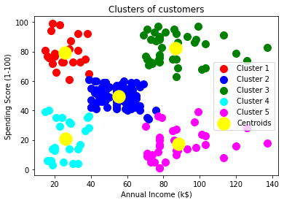
Visualising the clusters

